Slide 1


Biostatistics and data analysis
MSc. Kian Jenab
PhD student
Devision of Terrestrial Ecosystem Research
Centre for Microbiology and Environmental Systems Science
University of Vienna
Email: kian.jenab@univie.ac.at

Slide 2
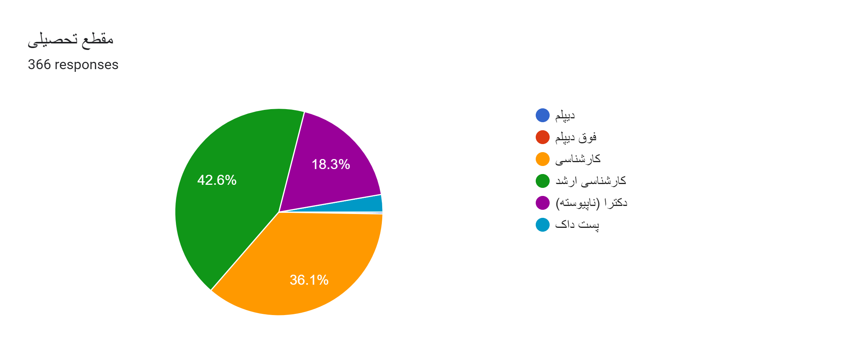
Based on Google form

Slide 3
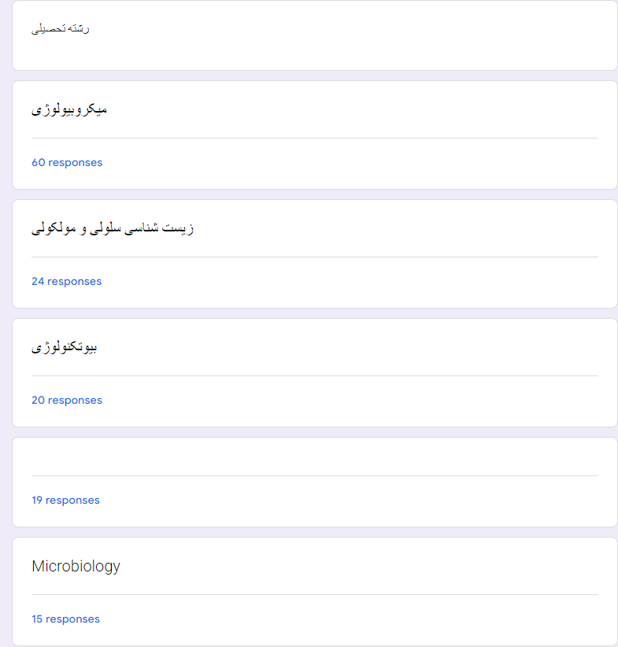
Based on Google form

Slide 4


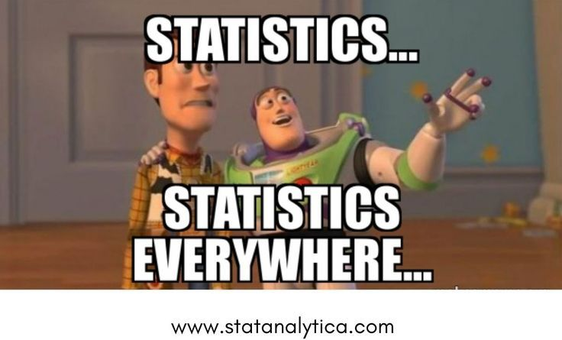



Requirements

Slide 5
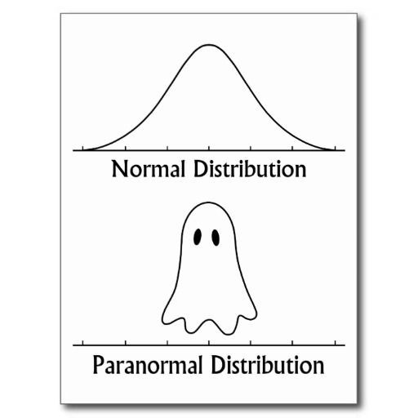
Schedule
10 Sesssions
Duration: 1.5 – 2 hours
Excercises and questions ➔ 30 minutes
Excercise for each session

Slide 6
Sessions
Introduction to statistics
Introduction to R I
Introduction to R II
Student’s t-test
Analysis of Variance
Non-parametric tests
Bivariate analyses
Data visualization I
Data visualization II
Multivariate Analyses

Slide 7
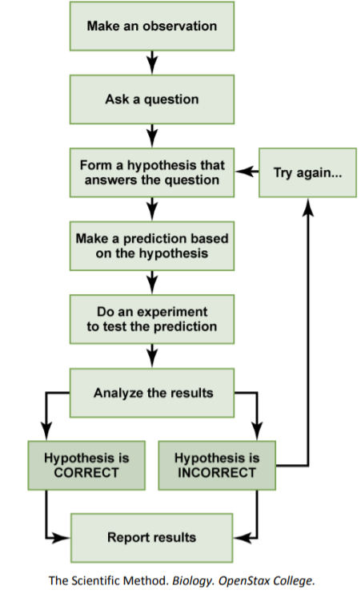

Slide 8
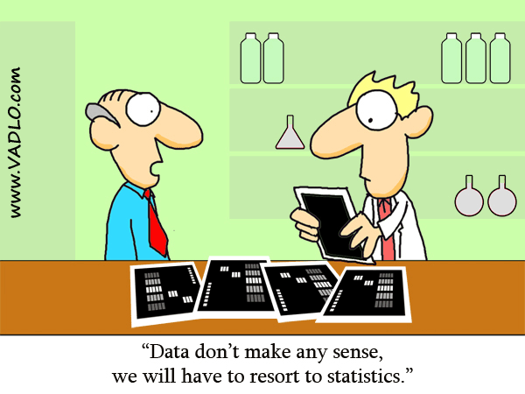
Statistics
Statistics: Collection, organization, analysis, interpretation and presentation of data
Biostatistic: Application of statistical methods to the solution of biological problems

Slide 9
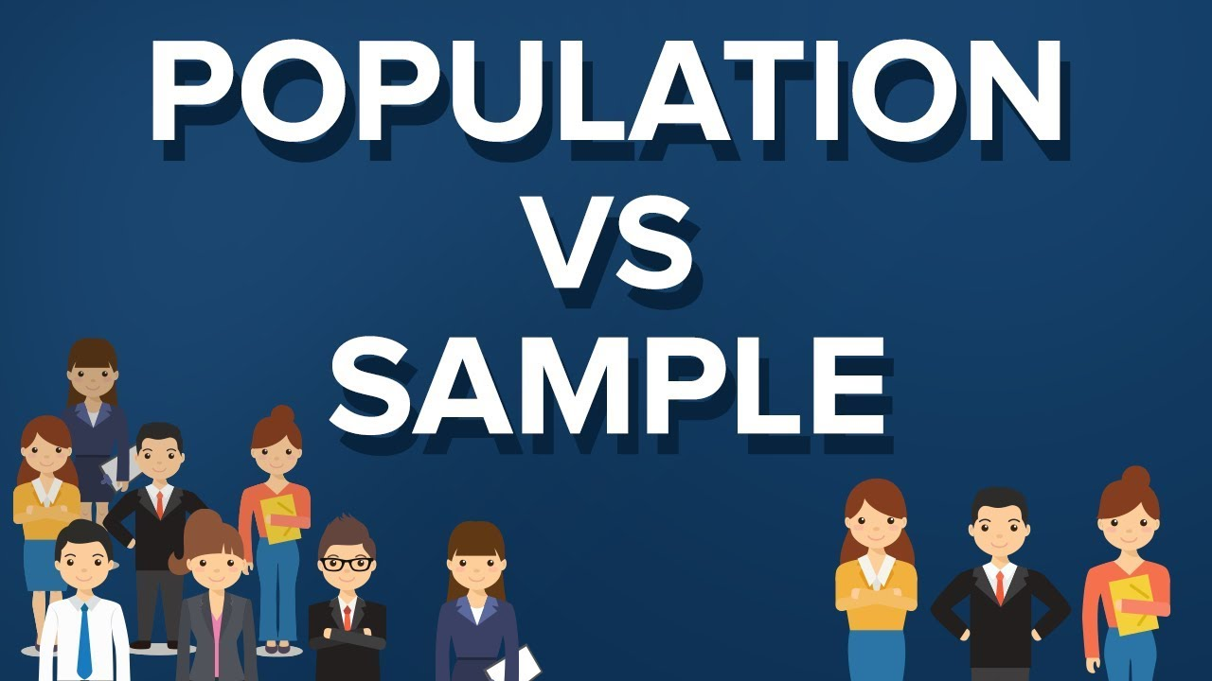

Slide 10
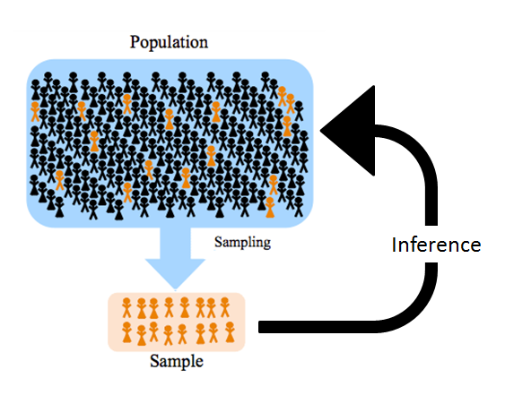

Slide 11
Population
Entire collection of people, animals, plants or things from which we may collect data
to make generalizations about a population study sample
Parameter: Information about population µ (Greek letters)

Slide 12
Sample
Group of units selected from a population
Sample unit: A person, animal, plant or thing, which is actually studied by a researcher (a value for each Variable)
Statistic: Information about sample S (English letters)

Slide 13
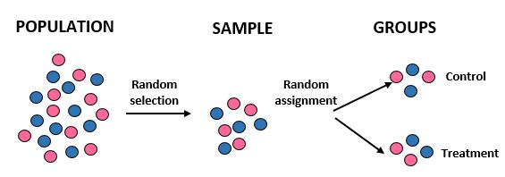
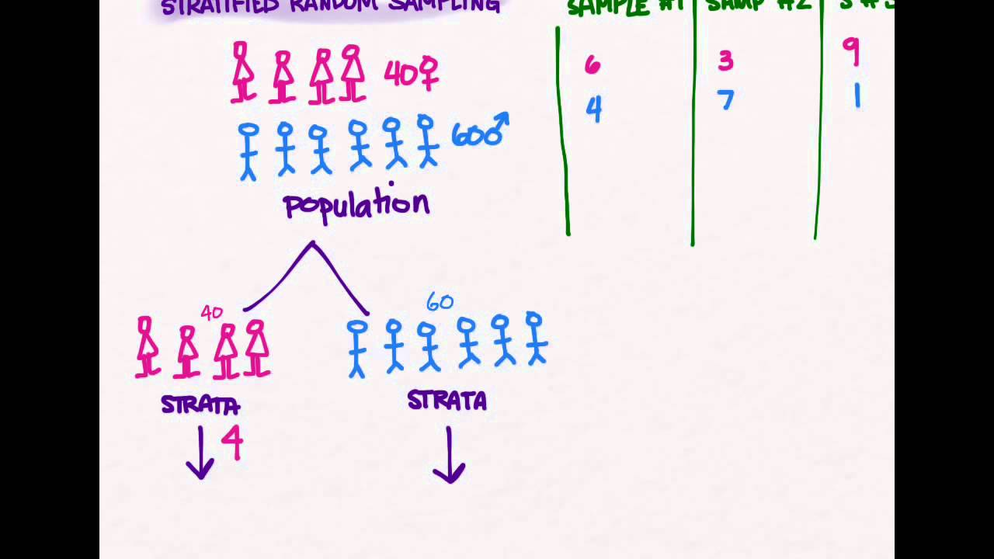
Collection
Sampling
Random sampling
Random assignment
Stratified random sampling
Non-random sampling
Census
Whole population
Random assignment
Stratified random sampling

Slide 14
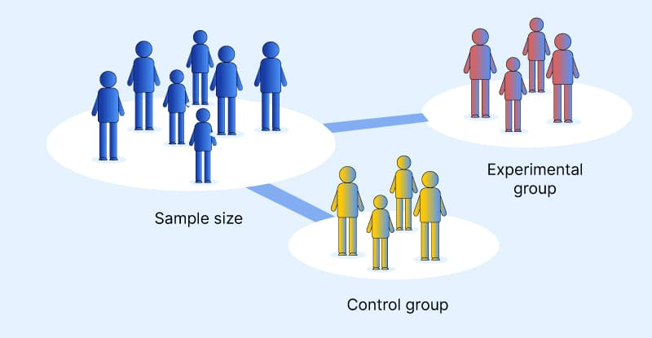


Slide 15
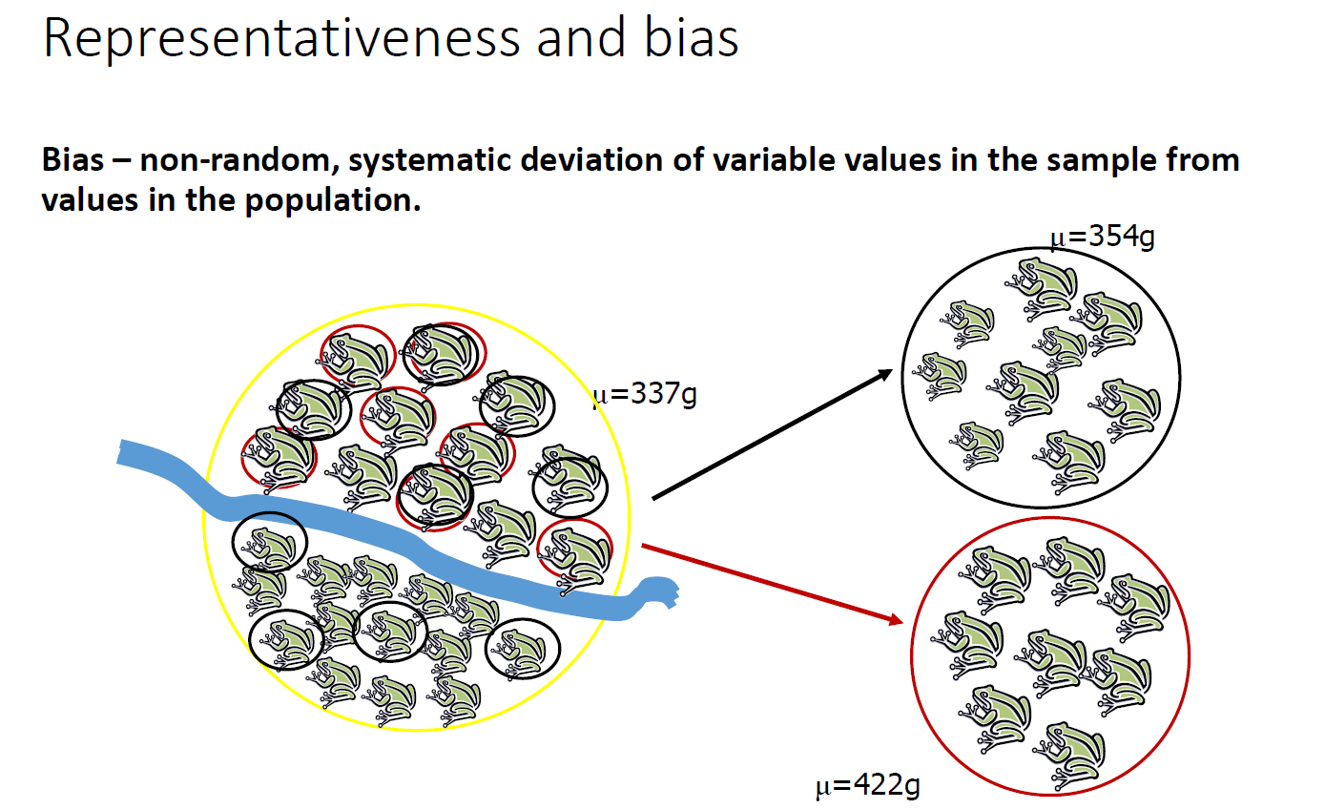

Slide 16
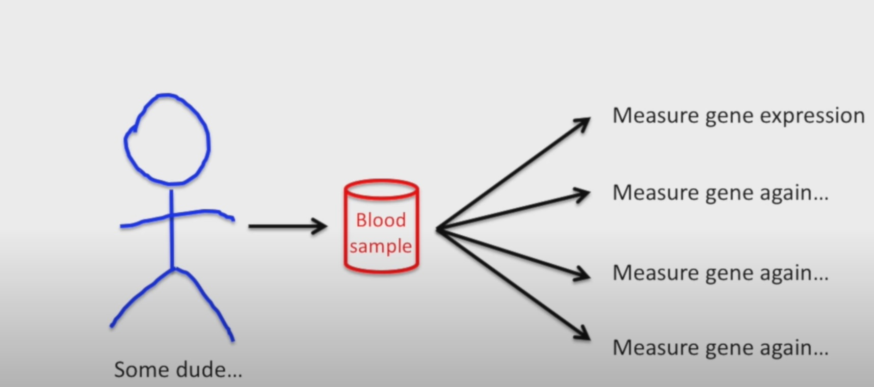
Technical Replicates
Youtube channel – StatQuest by Josh Starmer

Slide 17
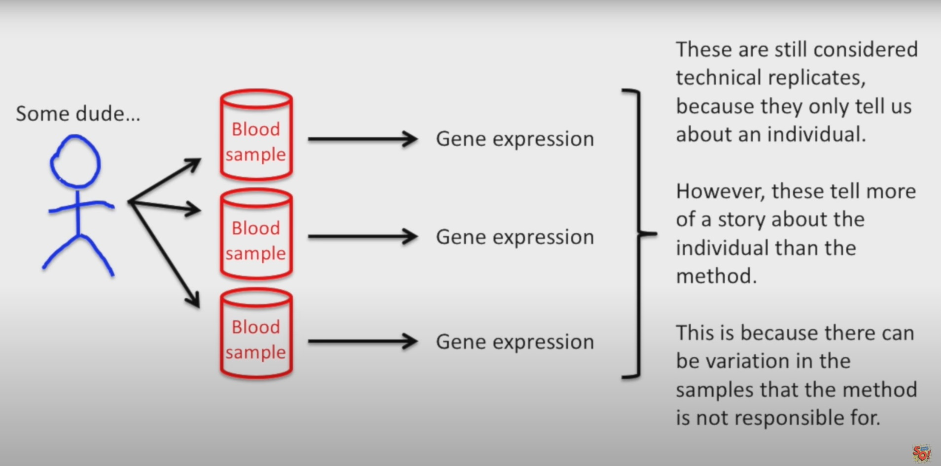
Technical Replicates
Youtube channel – StatQuest by Josh Starmer

Slide 18
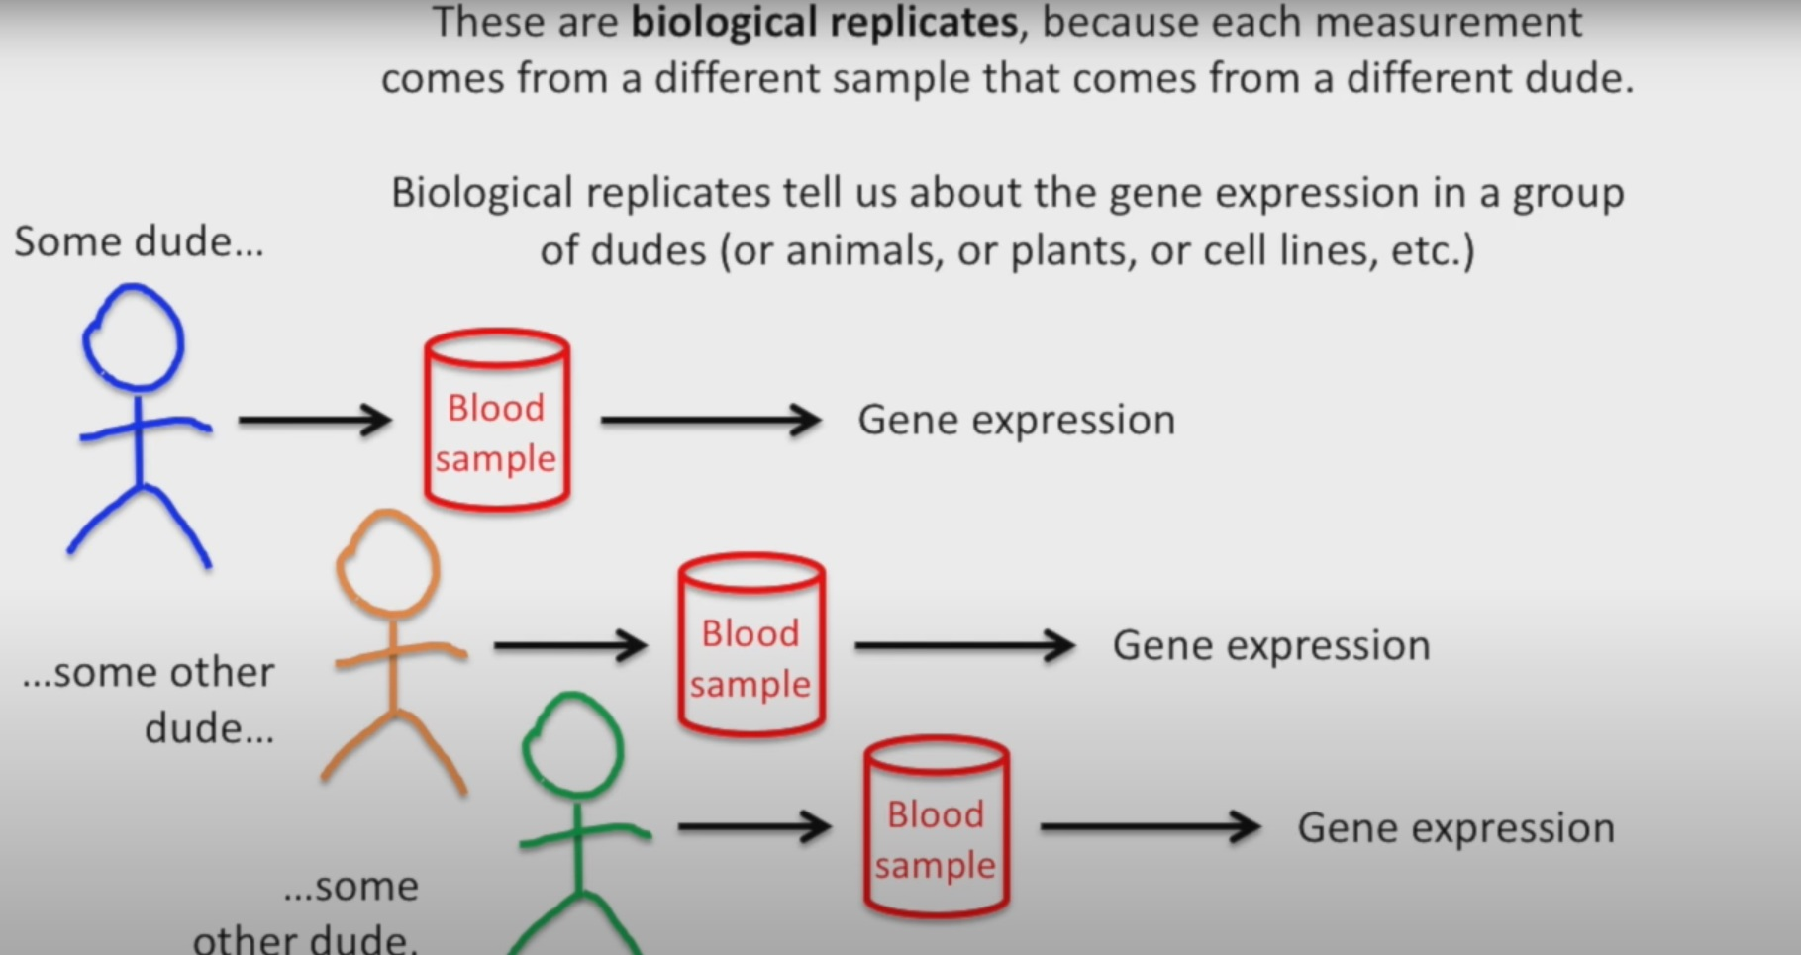
Biological Replicates
Youtube channel – StatQuest by Josh Starmer

Slide 19
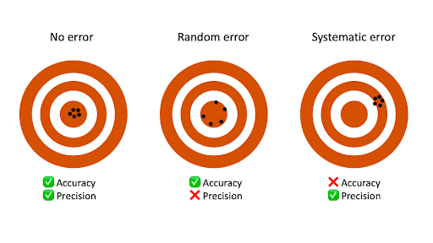
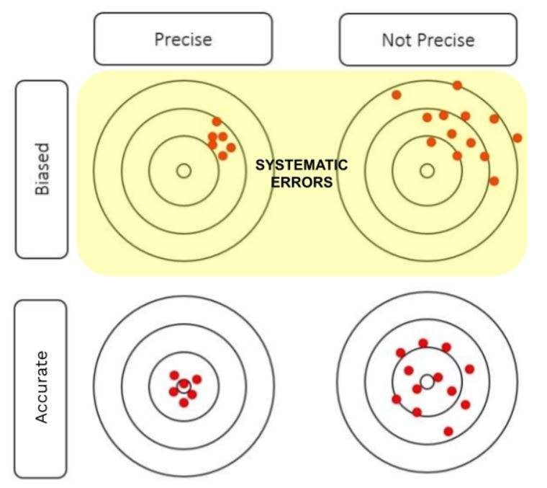
Measurements

Slide 20
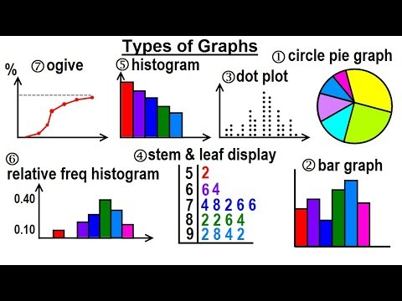
Organization
Table
Graph

Slide 21
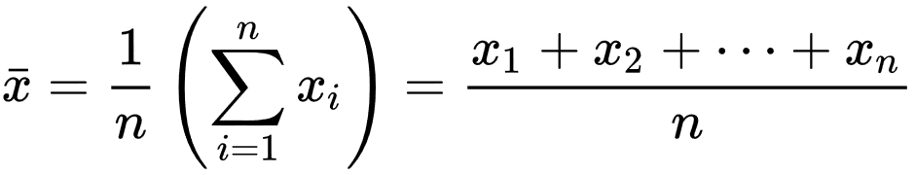
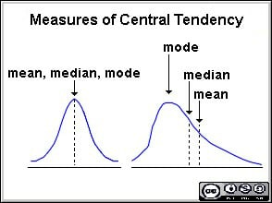
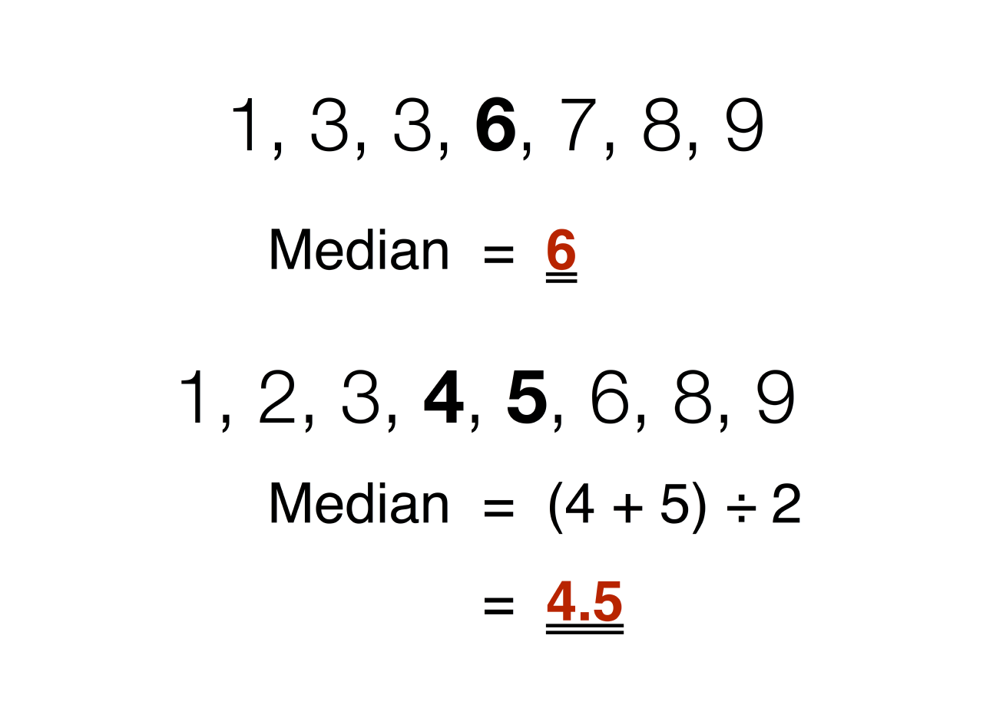
Central Tendency (Descriptive statistics)
Mean (µ)
Arithmetic mean
Median
Mode
The most frequent value

Slide 22
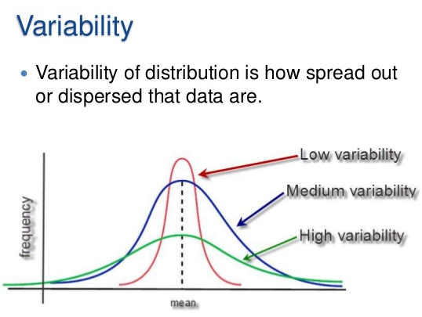
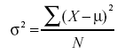
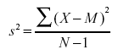
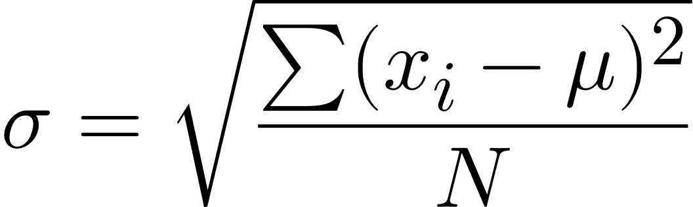
Dispersion (Descriptive Statistics)
Range = Max - Min
Variance
Standard deviation (S)

Slide 23
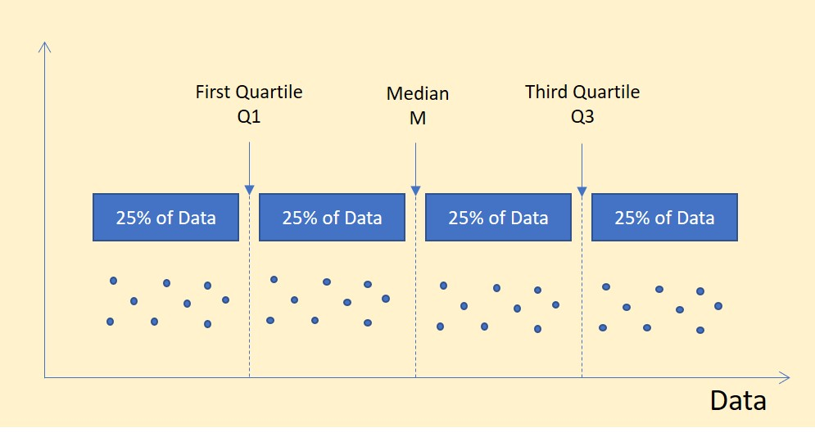
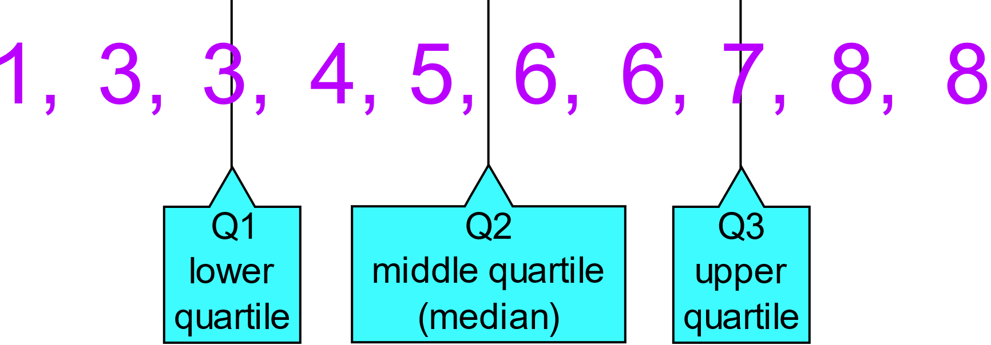
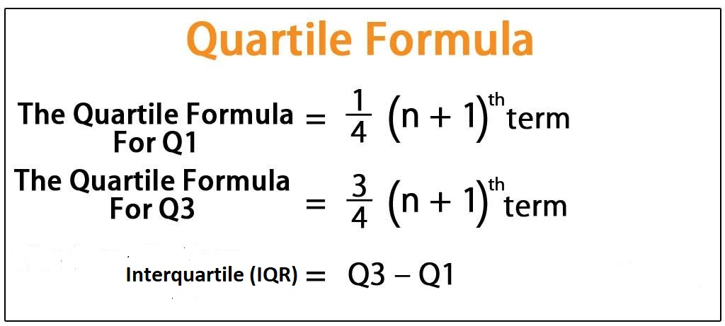
Quartile

Slide 24
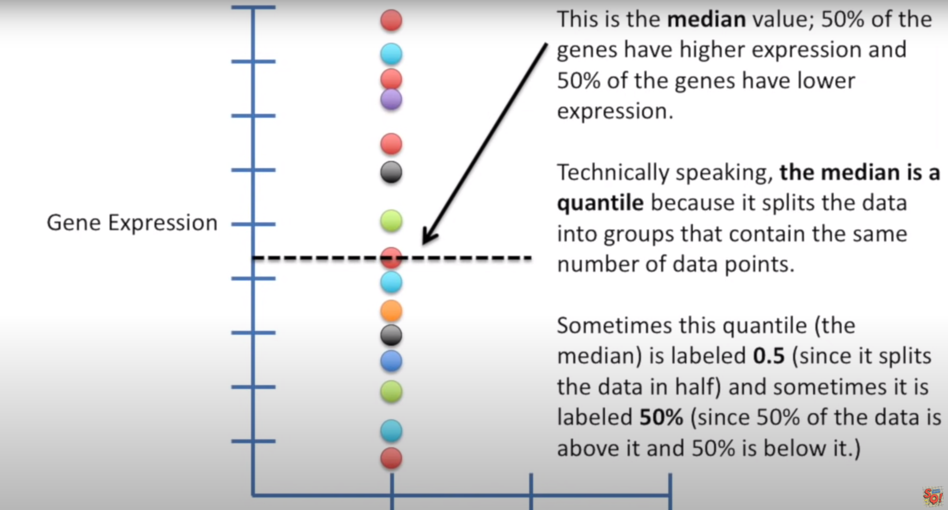
Youtube channel – StatQuest by Josh Starmer

Slide 25
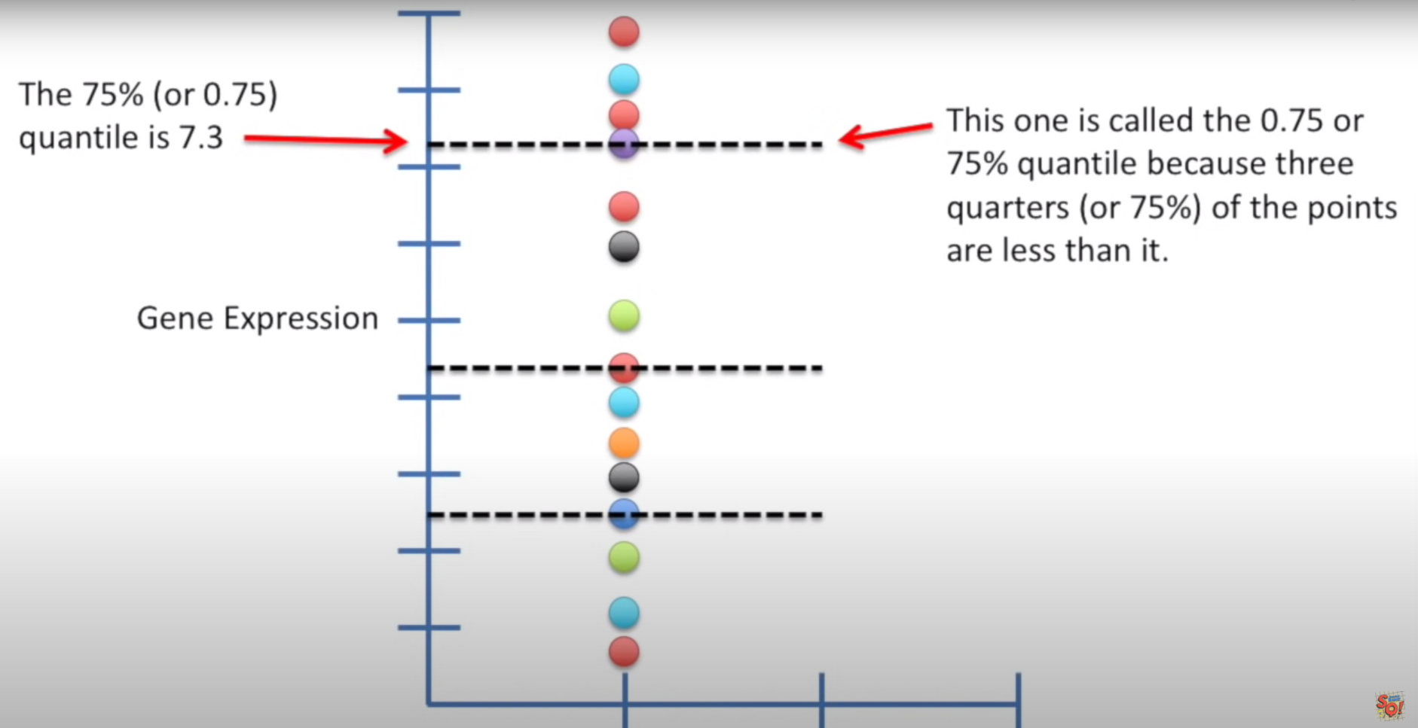
Youtube channel – StatQuest by Josh Starmer

Slide 26
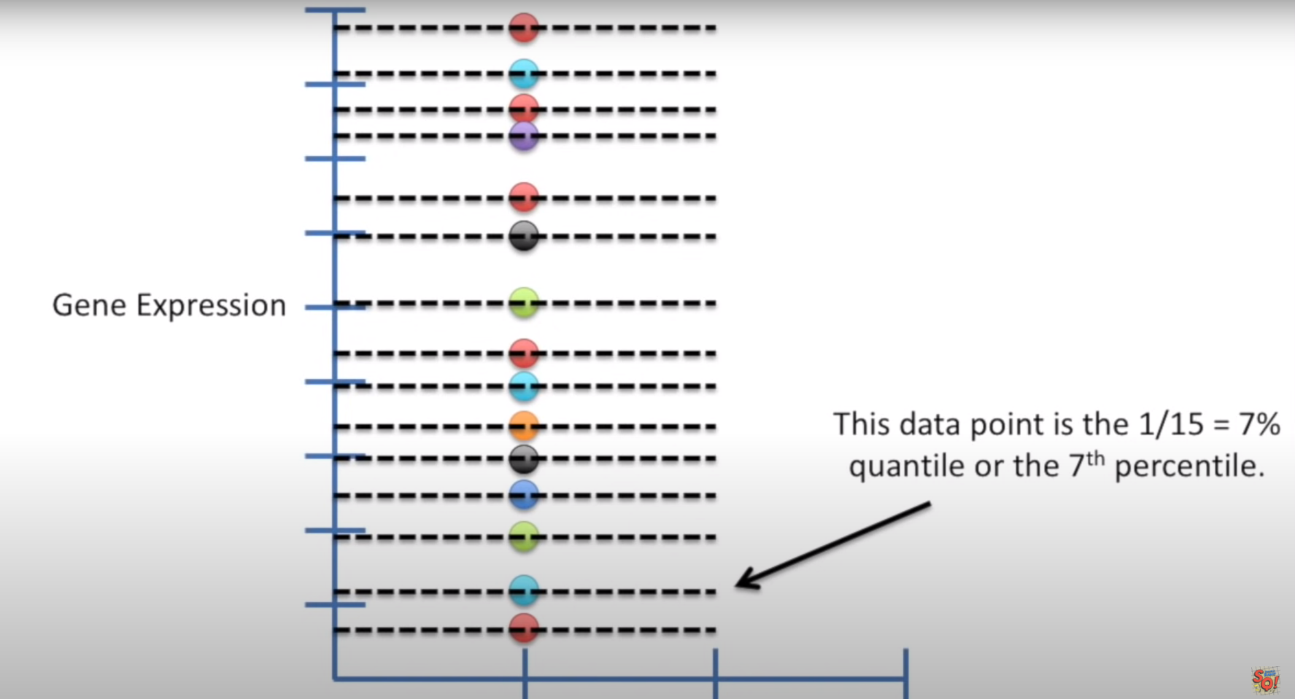
Youtube channel – StatQuest by Josh Starmer

Slide 27
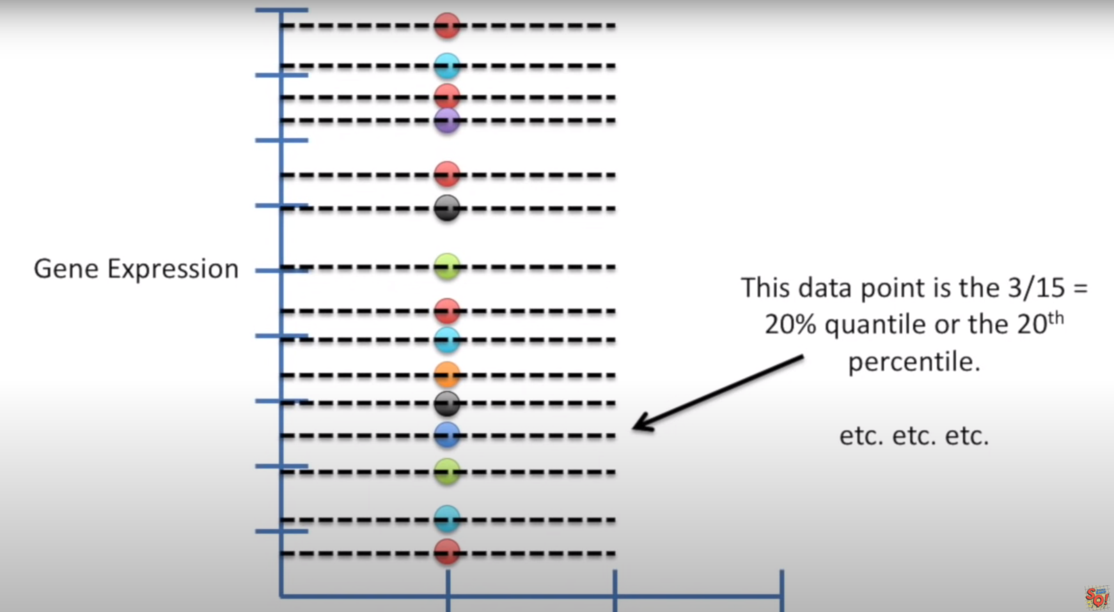
Youtube channel – StatQuest by Josh Starmer

Slide 28
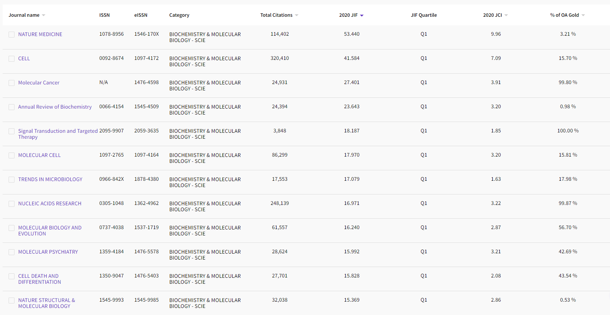
Web of Science

Slide 29
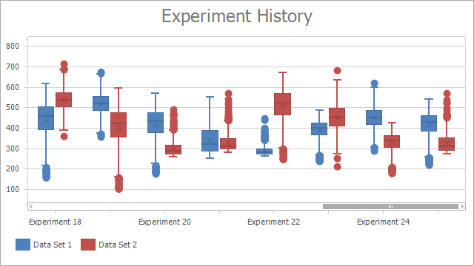
Box-Plot

Slide 30
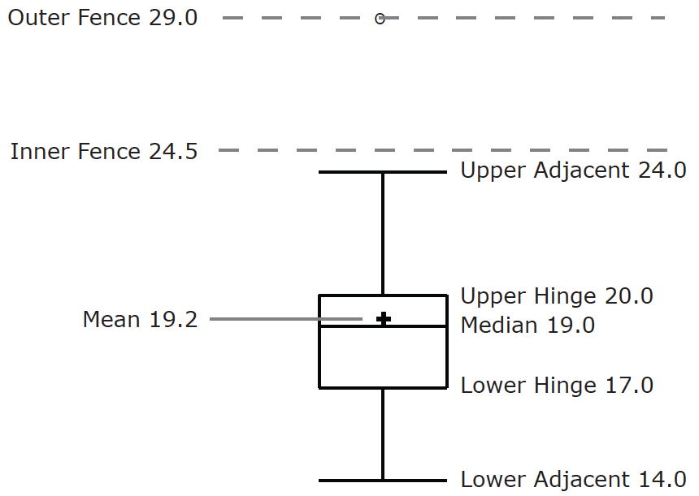
Box-plot
Name | Formula | Value
Upper Hinge | 75th Percentile | 20
Lower Hinge | 25th Percentile | 17
H-Spread | Upper Hinge - Lower Hinge | 3
Step | 1.5 x H-Spread | 4.5
Upper Inner Fence | Upper Hinge + 1 Step | 24.5
Lower Inner Fence | Lower Hinge - 1 Step | 12.5
Upper Outer Fence | Upper Hinge + 2 Steps | 29
Lower Outer Fence | Lower Hinge - 2 Steps | 8
Upper Adjacent | Largest value below Upper Inner Fence | 24
Lower Adjacent | Smallest value above Lower Inner Fence | 14
Outside Value | A value beyond an Inner Fence but not beyond an Outer Fence | 29
Far Out Value | A value beyond an Outer Fence | None
onlinestatbook.com

Slide 31
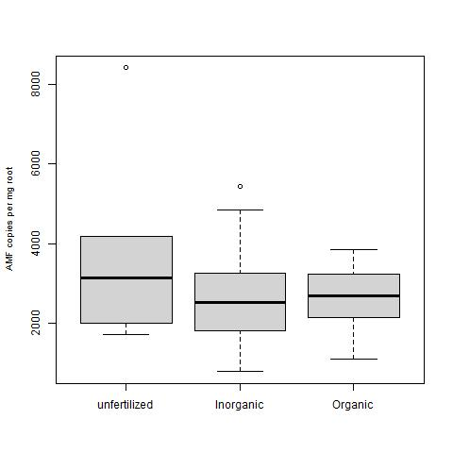
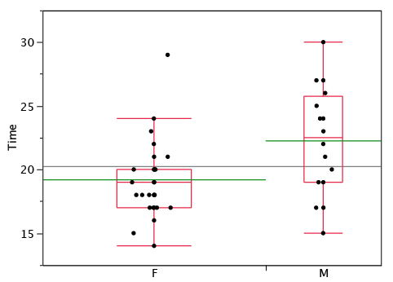
Box-plot
My project!
onlinestatbook.com

Slide 32
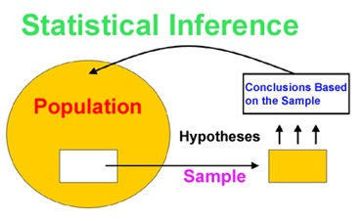
Statistical Inference
makes use of information from a sample to draw conclusions (inferences) about the population

Slide 33
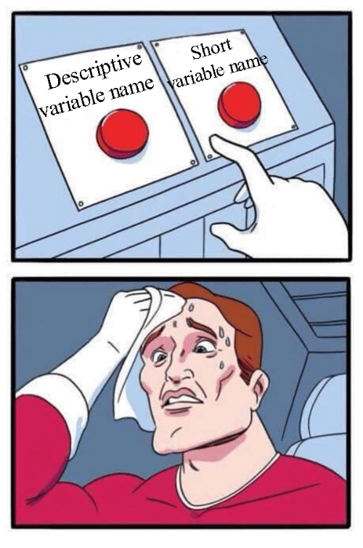
Variable
All attributes or features of an object that can vary
Examples:
Size, weight, colour, sex of indivduals
Number of species in habitats or sampling plots
Blood sugar, pressure, pH,........
etc. etc.

Slide 34
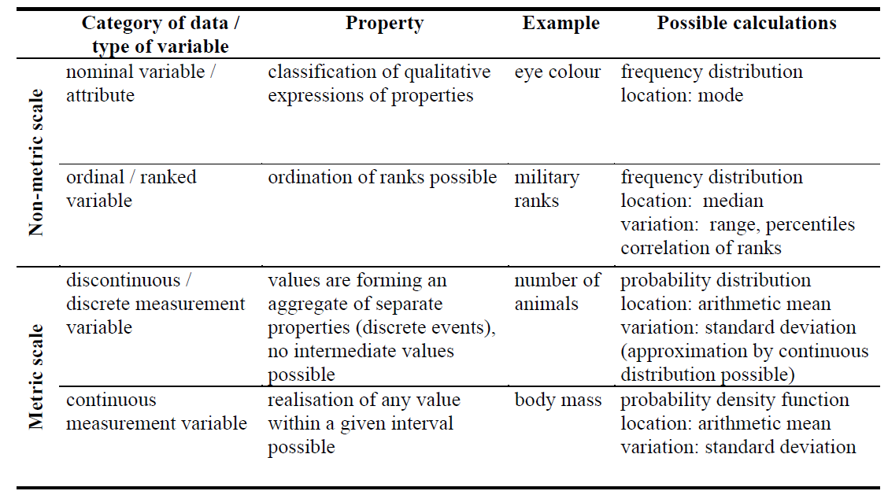
Variable

Slide 35
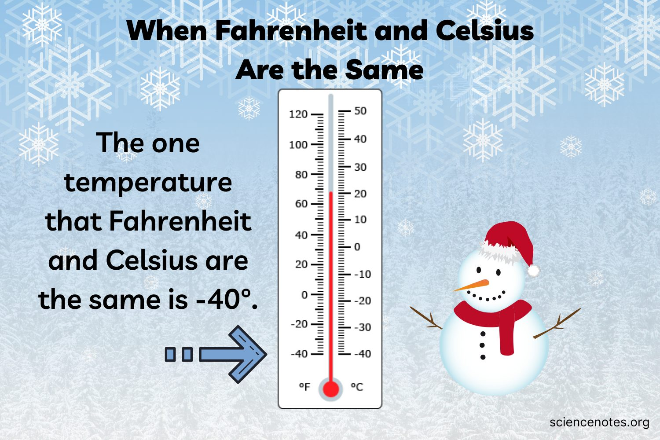
Metric Scale
Ratio variables
Have true zero
Example: Weight
Interval variables
Not have true zero
Example: temperature

Slide 36
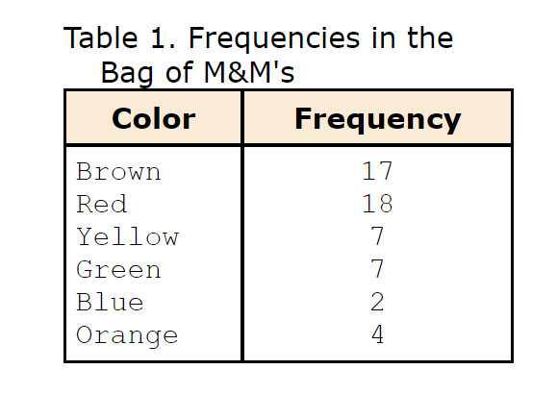
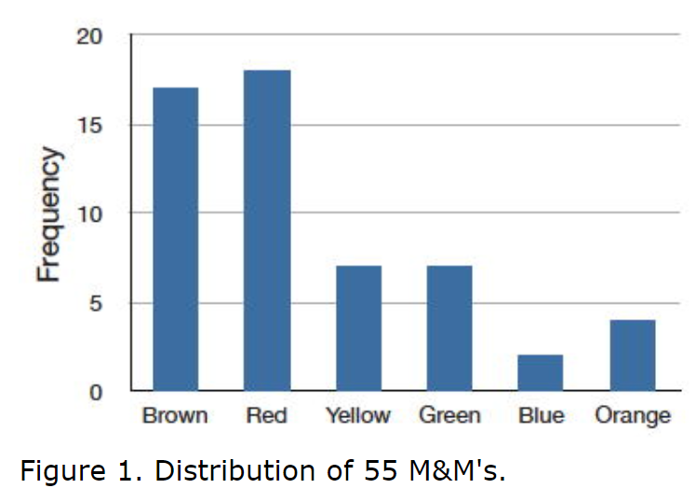
Distribution

Slide 37
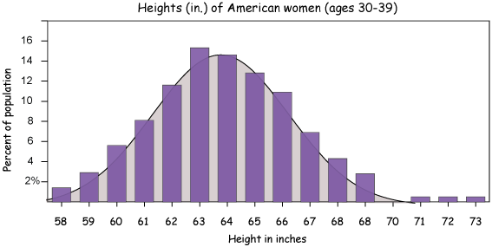
Distribution
Frequency distribution: how frequent is a certain, particular value (or value interval) within a given set of values.
Probability distribution: how likely is it that an object (to draw from a population) will have a certain value x.

Slide 38
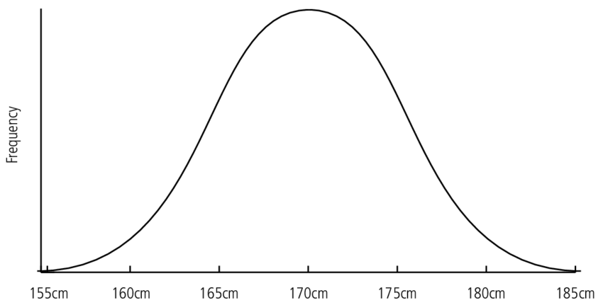
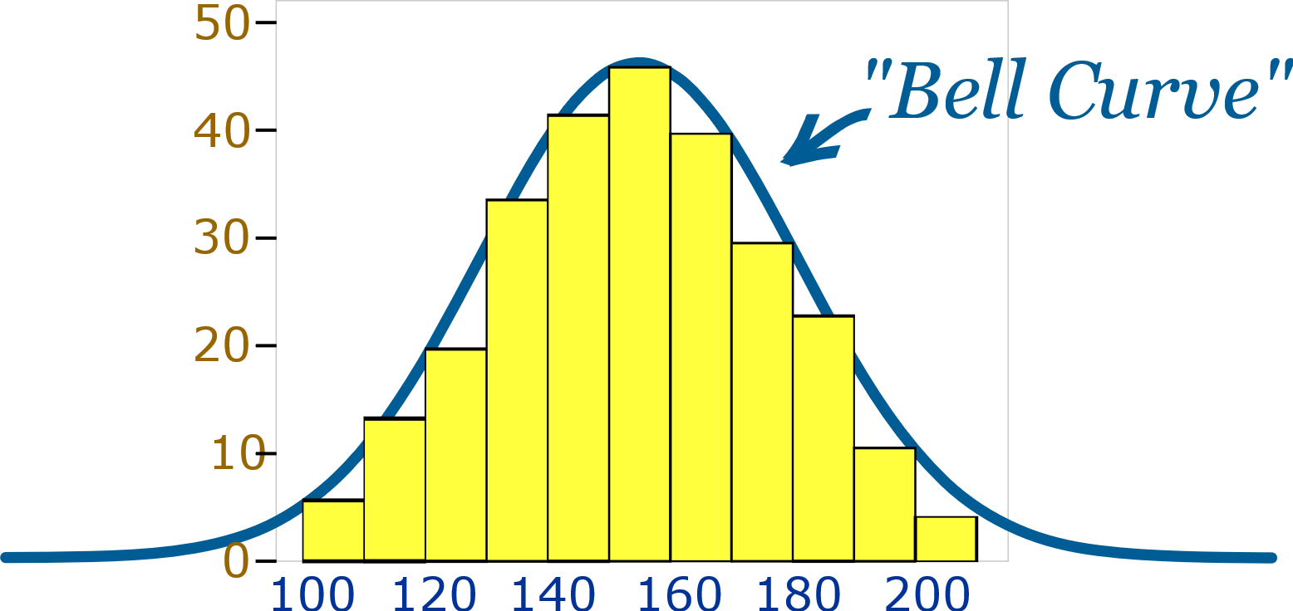
Probability Distribution

Slide 39
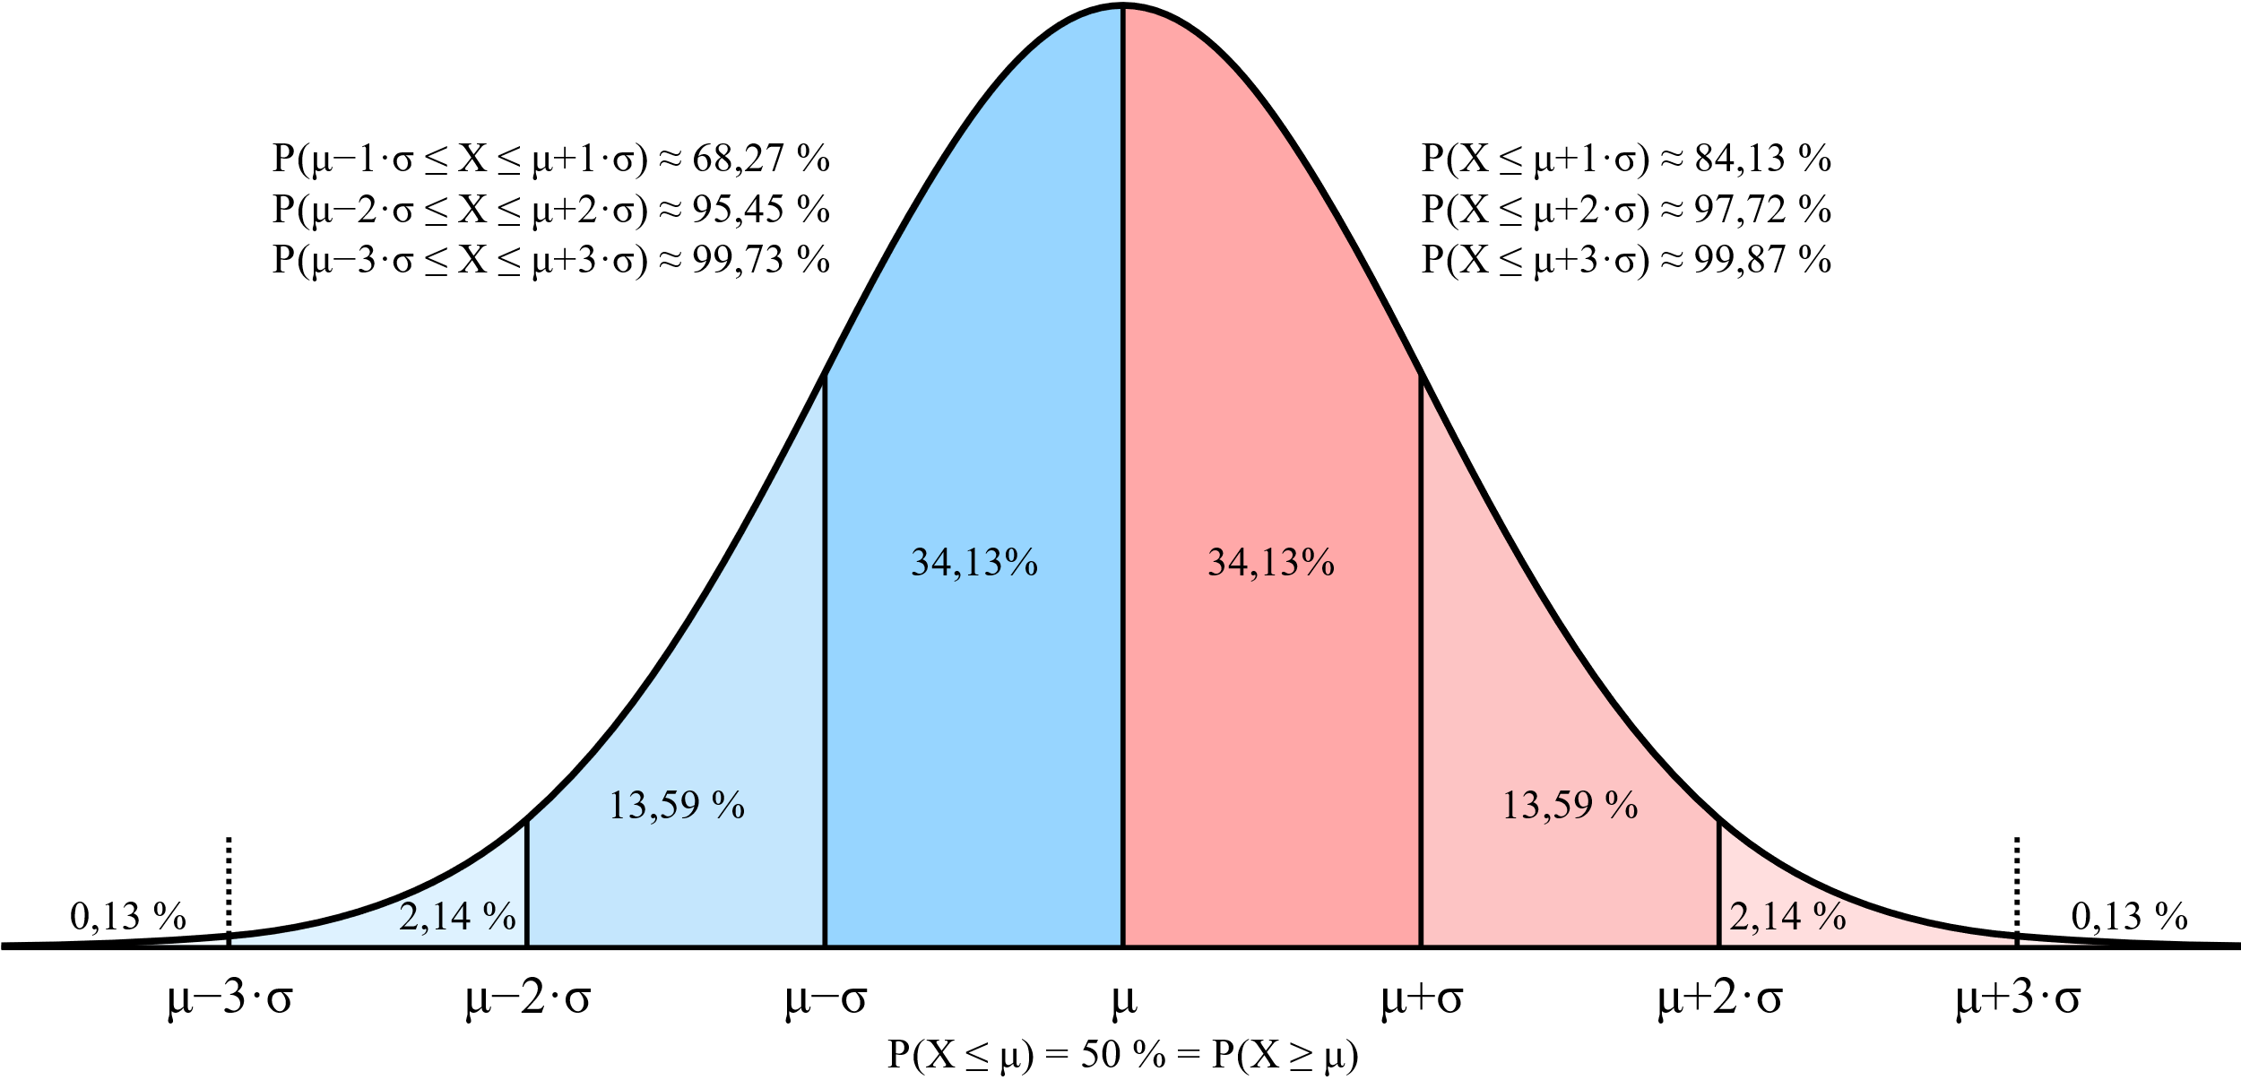
Normal distribution
Height
M: 175
S:5
175 ±5 :68.27%
175 ± 2(5): 95.45%

Slide 40
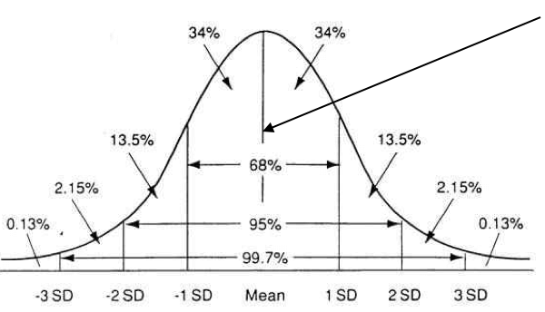

Slide 41
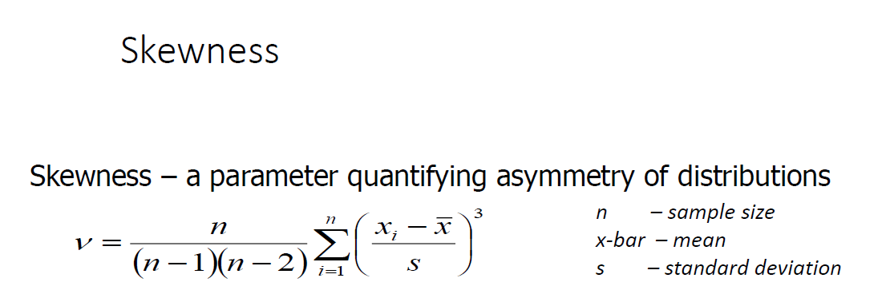
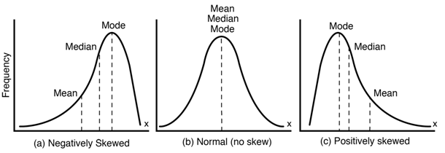
Skewness

Slide 42

normal
Left
Right

Slide 43


Kurtosis

Slide 44

Histogram

Slide 45

Histogram

Slide 46
Confidence Interval (CI)
Every parameter of a distribution can usually be calculated following a particular algorithm.
However, the sample is just a subset of all cases we are interested in (= population)
Problem: Estimating parameters of the population based on parameters of the sample.
Solution: Define an interval within which the parameter of the population is located with a probability of p (usually 95%).

Slide 47


Confidence Interval (CI)
How to calculate confidence intervals depends on distributions (and paramter, of course)

Slide 48

Bootstrap

Slide 49


Slide 50

Sample means
Central limit theorem (CLT)

Slide 51


Bar Chart

Slide 52


